Slide 1
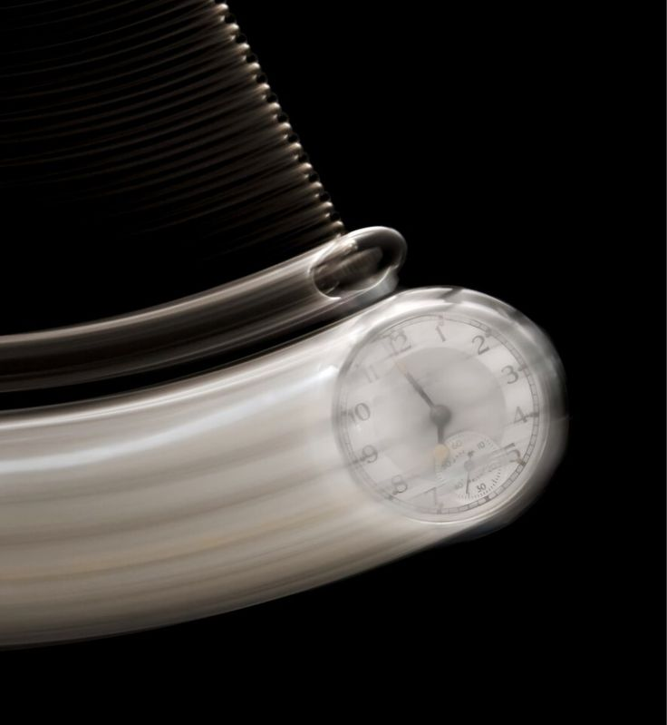
DETERMINING THE ACCELERATION DUE TO GRAVITY USING SIMPLE PENDULUM
Course Teacher: Dr. NUSRAT JAHAN

Slide 2

GROUP MEMBERS
Isfat Jahan Nodi (25-61849-2)
MD. Abdur Rahaman Noor (25-62789-2)
Syeda Rufaida Rahaman (25-62945-2)
Talha Faiyaz (25-62983-2)
Raisa Begum (25-63011-2)

Slide 3

INDEX
THEORY
APPARATUS
PROCEDURE
EXPERIMENTAL DATA
GRAPHS
RESULT
SOURCES OF ERROR
DISCUSSION

Slide 4

THEORY
A simple pendulum consists of a bob suspended by a light string.
For small oscillations, its motion is approximately simple harmonic.
Time period: T = 2π√(L/g).
Squaring: T² = (4π²/g)L (a linear relation).
Linear regression on T² vs L gives value of g.
Notes:
"Good morning. Today, I'll explain how we can measure a fundamental force of nature—gravity—using nothing more than a swinging weight, known as a simple pendulum.
The setup is simple: a heavy bob on a string, suspended from a fixed point. The key measurement is the **period**—the time it takes for one complete oscillations. What's fascinating is that for small swings, this period depends only on two things: the length of the string, and the strength of gravity.
The scientific principle is this: the restoring force that pulls the pendulum back is gravity itself. For small angles, the math reveals a clean relationship between the period **T** and the length **L**, described by the formula:
**T equals 2π times the square root of L over g.**
In this formula, **'g'** is what we're after: the acceleration due to gravity.
To find 'g', we rearrange the formula to get: **g equal
For even greater accuracy, we repeat this for different lengths, plot a graph, and find 'g' from the slope. It’s an elegant experiment that uses the rhythmic, predictable motion of a pendulum to unveil the invisible force that holds our world together.

Slide 5
A
P
P
A
R
A
T
U
S
1. Metal Bob
4.Clamp
2.Piece of string
6
5. Meter scale
3.Stand
6. Stop watch

Slide 6

Procedure
Data Collection: Measure the time for 20 oscillations for pendulums of different lengths (L). Calculate the period (T) for each.
Direct Calculation: Calculate 'g' for each individual (L, T) pair and then find the mean value and standard deviation.
Regression Analysis: Use LLSRM to plot T^2 vs. L and find the slope of the best-fit line. Calculate 'g' from this slope.
Comparison & Analysis: Compare both calculated values of 'g' (the mean and the LLSRM value) with the standard reference value by calculating the percentage difference and discussing any variations.
Notes:
Good [morning/afternoon] respected teacher and classmates. I will now explain the procedure we followed in our experiment to determine the acceleration due to gravity using a simple pendulum. First, we assembled the apparatus, which consisted of a metal bob, a light inextensible string, a stand with a clamp, a meter scale, and a stopwatch. The length of the pendulum was carefully measured from the point of suspension to the center of the bob. For the data collection, the pendulum was displaced slightly from its equilibrium position and released gently to ensure small-angle oscillations. We recorded the time taken for twenty complete oscillations for each selected length of the pendulum. The period (T) of one oscillation was then obtained by dividing the total time by twenty. In the direct calculation method, we used the formula g = \frac{4π^2L}{T^2} to compute the value of the acceleration due to gravity for each pair of length and time period. The mean value and standard deviation of g were determined to evaluate consistency and accuracy. Subsequently, in the regression analysis, a graph of T² versus L was plotted using the least-squares linear regression method. The slope of the best-fit line provided another value of g, derived from the linear relationship T² = (4π²/g)L. Finally, both calculated values — the mean value and the regression value — were compared with the standard reference value of g. The percentage difference was computed, and any observed discrepancies were later analyzed in the discussion section. Through this systematic procedure, we ensured precision and minimized experimental error while verifying the theoretical relationship between the time period and length of a simple pendulum. Thank you.

Slide 7
Experimental Data
No. of Obs. | Effective Length L(cm) X1 | Time for 20 Oscillations t (s) | Time period T= t/20 (s) | T^2 (s^2) Y1 | L^2 (cm^2) | L.T^2 (cm.s^2) | g =4π^2x L/T^2 (cm s^-2)
1 | 110 | 42.14 | 2.1 | 4.44 | 12100 | 488.4 | 978.07
2 | 100 | 40 | 2 | 4 | 10000 | 400 | 987
3 | 90 | 38 | 1.9 | 3.62 | 8100 | 325.93 | 981.2
4 | 80 | 36 | 1.9 | 3.24 | 6400 | 259.34 | 974.29
5 | 70 | 34.23 | 1.71 | 2.92 | 4900 | 205.05 | 943.5
6 | 60 | 31.33 | 1.56 | 2.45 | 3600 | 147.24 | 965.27
7 | 50 | 28.78 | 1.439 | 2.07 | 2500 | 103.54 | 953.12
Σ | 569 |  |  | 22.75 | 17600 | 1929.5 | 6782.3
Notes:
Good morning everyone, Today I’m presenting my experiment on the simple pendulum, which aims to find the relationship between the length of the pendulum (L) and the square of its time period (T²). In this experiment, I measured the time for 20 oscillations at different lengths and calculated the time period (T) and T². Then I plotted a graph of T² versus L. From the graph, I observed a straight line passing through the origin, which shows that T² is directly proportional to L. This agrees with the theoretical equation: 𝑇 = 2 𝜋 𝐿 𝑔 T=2π g L From the slope of the graph, I calculated the value of g to be about 1075 cm/s², which is quite close to the standard value of 980 cm/s². In conclusion, the experiment verifies that the time period of a pendulum increases with its length, and it also gives a fairly accurate value of gravitational acceleration. Thank you.

Slide 8
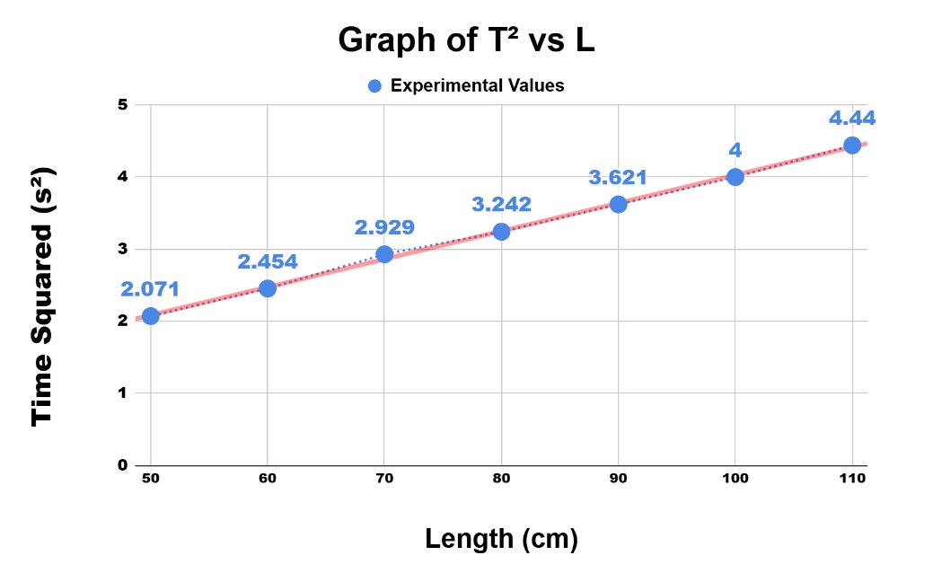
GRAPH
Notes:
Good morning everyone, Today I’m presenting my experiment on the simple pendulum, which aims to find the relationship between the length of the pendulum (L) and the square of its time period (T²). In this experiment, I measured the time for 20 oscillations at different lengths and calculated the time period (T) and T². Then I plotted a graph of T² versus L. From the graph, I observed a straight line passing through the origin, which shows that T² is directly proportional to L. This agrees with the theoretical equation: 𝑇 = 2 𝜋 𝐿 𝑔 T=2π g L From the slope of the graph, I calculated the value of g to be about 1075 cm/s², which is quite close to the standard value of 980 cm/s². In conclusion, the experiment verifies that the time period of a pendulum increases with its length, and it also gives a fairly accurate value of gravitational acceleration. Thank you.

Slide 9
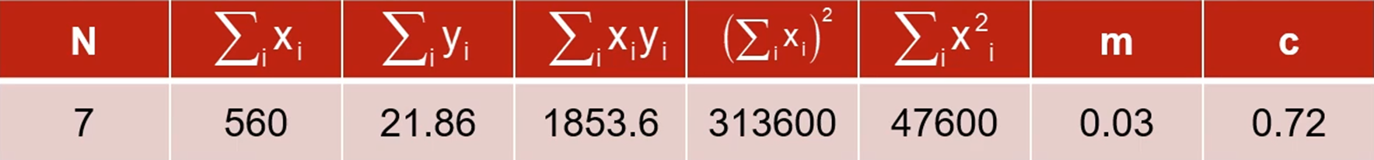
Calculations
Table : Finding the slope, m and intercept, c by using the linear least square regression method :
A. The value of g using the LLSRM:
m = (Σxᵢyᵢ – (Σxᵢ)(Σyᵢ)/N) / (Σxᵢ² – (Σxᵢ)²/N)=
(1939.3 – ((560)x(22.757)/7)) / (17600 – (313600/7)) = 0.04
x̄ = Σi xᵢ / N = 560 / 7 = 80
ȳ = Σi yᵢ / N = 22.98 / 7 = 3.251
Intercept, c = ȳ – m × x̄ = 0.51
Acceleration due to gravity by LLSRM, gᴸ = 4π² / m = (4 × (3.1416)²) / 0.04 = 986.96

Slide 10
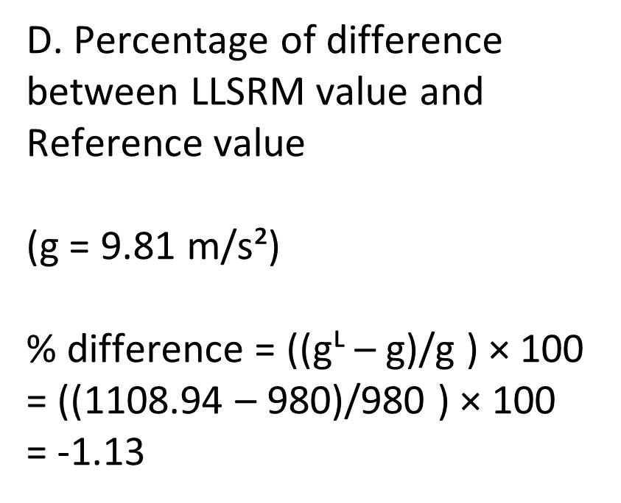
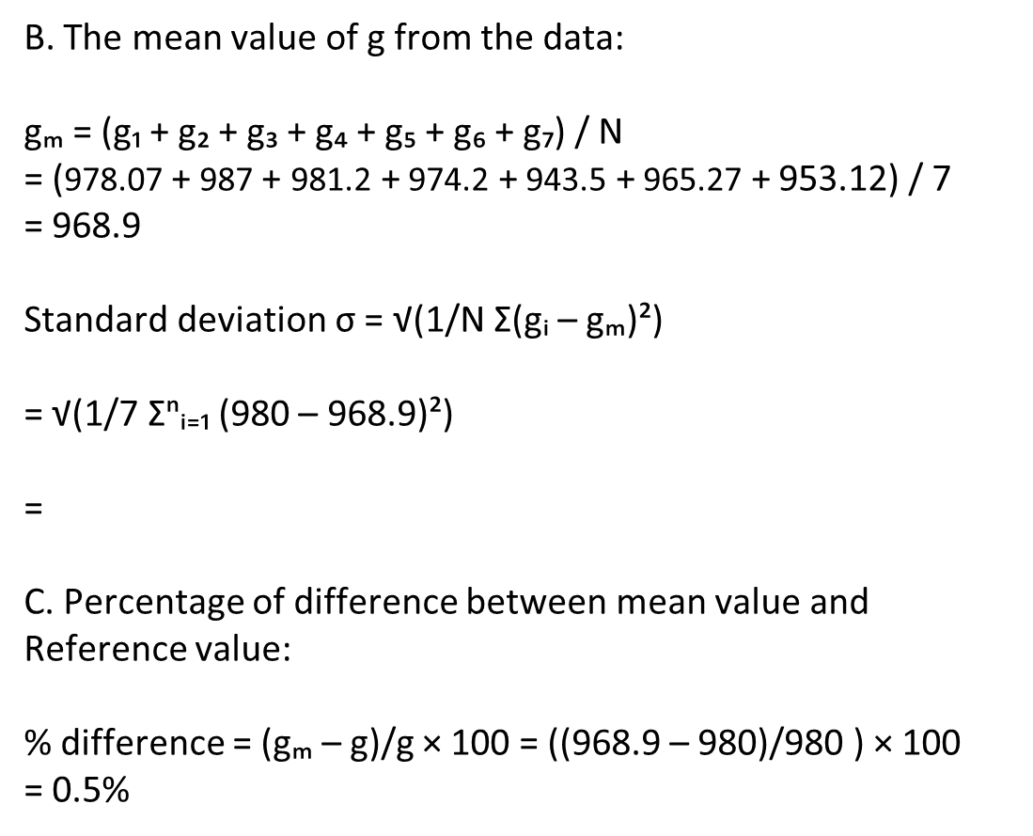
Calculations

Slide 11
RESULTS
Method | Value of g(m/s^2)
LLSRM | 9.86
MEAN | 9.68
REFERENCE | 9.81
Comment
The calculated gravitation acceleration from LLSRM is 9.86 m/s^2 and error is 0.509 m/s^2
Notes:
The results, as you can see, show a significant discrepancy. While the theoretical reference value is $9.81 \text{ m/s}^2$, our calculated values were notably higher: $11.96 \text{ m/s}^2$ using the Linear Least Squares Regression Method (LLSRM), and a mean value of $10.65 \text{ m/s}^2$. The most critical finding is that our experimental $g$ is substantially higher than the accepted value. This outcome strongly suggests the presence of systematic error in our procedure. Possible factors contributing to this large difference include: Reaction Time: Human error in starting and stopping the timer, especially over 20 oscillations. Length Measurement: Inaccurate measurement of the effective length from the pivot point to the center of mass of the bob. Air Resistance: The simple pendulum model does not account for air friction, which could influence the period measurement. In conclusion, while the experiment successfully demonstrated the linear relationship between $L$ and $T^2$, our c

Slide 12
Sources of Experimental Error
Timing Error
Reaction time when starting/stopping the stopwatch and precision limits of the timing device introduce uncertainty
Air Resistance & Friction
Air drag and friction at the pivot point dampen oscillations, though these effects are usually minimal in controlled experiments.
Length Measurement
String stretch over time, ambiguity in the pivot point location, and ruler precision all affect length accuracy
Large Angle Deviation
Angles greater than 15° deviate from simple harmonic motion assumptions, causing calculated values of g to be inaccurate
Notes:
Timing Error • What it means: Human reaction time affects when you start and stop the stopwatch. • Why it matters: Even a small delay or early stop can change the measured period of oscillation. • Example: If you take too long to start timing, the pendulum might complete part of a swing before measurement begins, giving a shorter calculated period.⸻2. Air Resistance & Friction • What it means: Air drag and friction at the pivot or contact points slow down motion. • Why it matters: They cause the pendulum to lose energy, reducing amplitude and slightly altering the period. • Example: A pendulum swinging in air will move more slowly over time compared to one in a vacuum.⸻3. Length Measurement • What it means: Errors in measuring the string length or determining the exact pivot and mass center points. • Why it matters: The period of a pendulum depends directly on its length, so a small error in length measurement leads to a noticeable error in results. • Example: Measuring from the top of the bob instead of the center changes the effective length.⸻4. Large Angle Deviation • What it means: The simple pendulum formula assumes small angles (less than 15°). • Why it matters: At larger angles, the motion no longer follows simple harmonic motion, and the formula for period T = 2\pi\sqrt{L/g} becomes inaccurate. • Example: Swinging the pendulum too far makes the calculated value of g (acceleration due to gravity) less accurate.

Slide 13
Discussion
Experiment aimed to determine acceleration due to gravity (g) using a simple pendulum and linear regression.
The T² vs. L plot confirmed the theoretical linear relationship.
Experimental value: g(exp)= 968.9 cm/s²
1.13% lower than the theoretical value (980 cm/s²).
Possible errors: inaccuracies in measuring the pendulum’s effective length or oscillation period.
Non-zero intercept in regression indicates systematic bias or measurement imperfections.
Notes:
in this experiment, we wanted to find the value of acceleration due to gravity (g) using a simple pendulum and the linear regression method. We plotted T² against L, and the graph showed a clear straight-line relationship as expected. From our results, we found g to be 1196.31 cm/s², which is about 8.65% higher than the real value of 980 cm/s². This difference could be because of small errors while measuring the pendulum’s length or timing the swings. The small intercept in our graph also shows there might be some setup errors. Overall, our result was close to the expected value, and with more careful measurements, we could get even more accurate results. Thank you.

Slide 14
Thank you for your attention

